Slide 1
Application guidance and role information: Driving Examiner May 2022
Notes:
Front screen for starting the meeting.
We did find that if you are visible to all through the meeting we did get more engagement, however it will be your personal choice.

Slide 2
What will we be covering today?
Who we are and what we do
The benefits you can expect
What you will be doing as a driving examiner
What skills you will need.
The selection process
The training schedule
Examples of working patterns
Q&A session
Notes:
Thank you for joining ***Introduce yourselves***.
We have volunteered to deliver this session to give a generalist overview on working for DVSA and information pertaining to the Driving Examiner Job.
We will be delivering a session today covering *** run through the bullet points***
We will be running through the slides so we ask that you stay on mute and please pop any questions into the chat function. We will answer these as we go along and we will open up at the end of the session for any questions or chat about the role etc.
You will be sent a copy of this presentation following this session and if we cannot answer your question today please email recruitment.Newcastle@dvsa.gov.uk

Slide 3
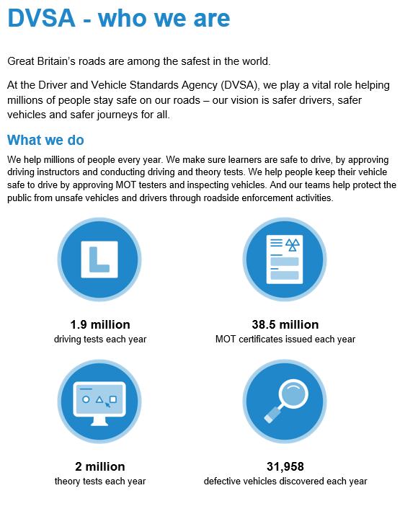
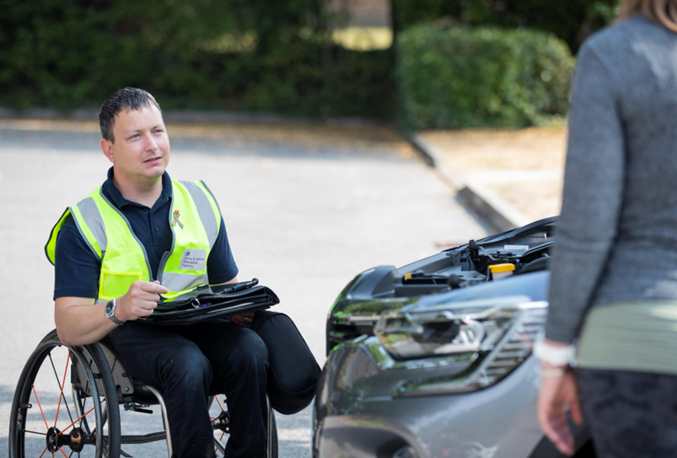
Notes:
Please run through the slides and give a brief overview of who the DVSA is and what we do and how this contributes to our mission of making Great Britian’s roads among the safest in the world.

Slide 4
Notes:
Go over the different benefits we offer such as flexible working, annual leave modern IT, ipad, access to learning opportunities and the staff discounts we have access to.
Flexible working, we are happy to discuss your requirements with you, if the general working patterns are not suitable, please do come and talk to us.
Generous annual leave
Modern IT
Access to learning
Childcare, parental and carer policies
Discount portal and cycle to work schemes.

Slide 5
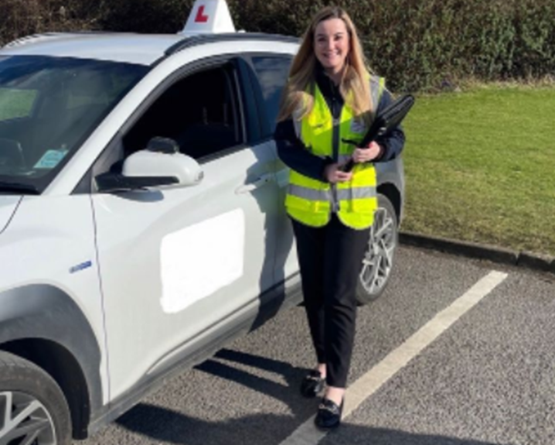
What will you be doing?
Driving Examiners play a vital role in road safety. When trained you will use your knowledge to judge whether customers pass their driving test.
You will work within a cluster. This means you will be expected to travel to any of the locations within that cluster.
Carry out car driving tests, building rapport with the customer, be professional ensuring you tailor your approach to consider any needs customers may have.
You’ll supervise the test and assess the level of driving displayed by the customer, ensuring they reach the required standard and accurately complete test reports.
Support the Local Driving Test Manager when you’re not carrying out tests and work with your colleagues to maintain an effective working environment.
Notes:
Run through what an examiner does on a day to day basis
Where they will be based
How they are expected to work

Slide 6
What skills do I need?
The role of a Driving Examiner is unique and as such you need a unique set of skills
Being able to multitask is essential – you will have to supervise the test, observe the candidate and the road and mark the test simultaneously!
Communication skills – the ability to communicate with different people with different abilities and requirements is a skill you will come to rely on to make the customer feel relaxed and in the best possible place to take their test
Motivation to learn – becoming a Driving Examiner is no easy task. Being open to learning new things and to take on feedback will help you on your journey
Good level of driving experience with a thorough knowledge of road safety and the highway code.
Notes:
Run through the skills needed
Multi - tasking
Communications skills
Empathy
Good customer service skills

Slide 7
Selection process
Stage 1 – the Civil Service Judgement Test
This is a generic civil service test.
It measures your ability to demonstrate judgement and decision-making regarding specific Civil Service Behaviours.
This means that some of the questions you are asked may not seem relevant to the role, such as office-based questions.
However, it is important that we test you as a civil servant at the correct grade, and not just as a Driving Examiner and as such will use a range of different questions in different scenarios.
You can find more information online Judgement test.
Notes:
The DVSA use Success Profiles to assess applications hroughout our entire selection process.​
Success Profiles were introduced across The Civil Service to help make it the most inclusive employer in the UK. You can find more information using the link in the back of pack
Generic civil service test
Testing you as a civil servant at EO grade, not just as a driving examiner
Gives us a rounder picture of your abilities
Pass or fail test.
There are practice tests on the website just click the link to go through

Slide 8
Selection process
Stage 2 – online recorded interview.
This can be done at anytime of the day. You will have a deadline as to when the interview should be completed. Each question will have a time limit for you to present your answer. We will ask you a question based on a behaviour listed in the job description. You should try and prepare as best as you can prior to starting your interview.
Stage 3 - drive assessment
You will be invited for a drive assessment. This will be about 60 minutes long, including the driving. You will be assessed on planning, ie how you approach roundabouts, awareness, speed and general driving ability.
We provide the vehicle for you and there is a video you can view on the Driving Examiner page DVSA Driving Examiner Roles - Department for Transport Careers (dft.gov.uk)
Notes:
Please run through the steps on the slide, All of the information is available on the advert on Civil Service Jobs and Candidate Pack.
Stage 2 Interview – Online recorded interview, that can be done at any time to suit you within the given deadline. Guidance and further information will be sent to you as part of your invitation.
Drive – A drive assessment at a local test centre, DVSA will supply you with a vehicle.
Play video (if we have it ready)

Slide 9
Behaviour Interview
A behaviour is an evidence-based example on a specific topic. You will need to provide information that demonstrates your actions, activities and result which relate to the behaviour being assessed. It’s about what you did, how you did it and what the result was.
We will tell you at the beginning of the question which behaviour it relates to and the question will be written at the side of the screen. You’ll need to provide information on what happened, the actions you took and the result (positive and negative, don’t be afraid to use unsuccessful outcomes).
Use all areas of your life to identify behaviour examples (work/non work).
Look at the Success Profile behaviour dictionary to align your example to the descriptors, this will help you identify examples you have and to prepare some information ready for your interview. Think about using the STAR technique for formulating your response Situation, Task, Action and Result.
Don’t assume we know what you are talking about.
Always ensure that you have answered the question.
Avoid WE and focus on I. We want to know what YOU have done.
Use engaging language, capture our attention, make yourself stand out.
Notes:
Run through what a behaviour interview is and how we assess them against the civil service behaviours
You can find all the behaviours on the gov.uk site, and there is a link inclided at the back of this pack. You should be looking at the level 2 or EO grade behaviours in section 3. These will give you an idea of the information we are looking for in your answers.

Slide 10
The Training Schedule
The training course will last a minimum of 5 weeks and will be on a full-time basis. You will need to pass each stage of the training to move to the next.
The DVSA has training locations across the country, they are in Aberdeen, Avonmouth, Beverly, Birmingham, Bishopbriggs, Brentwood, Cambridge, Chadderton, Farnborough, Gillingham, Gosforth, Leeds, Llantrisant, Norwich, Plymouth, and Slough.
Although we will make every effort to locate you at your nearest training location, there may be occasions when you are asked to travel to other locations, with DVSA covering the costs.
The first week will be conducted virtually, after that you’ll focus on driving ability and familiarise yourself with the skills required to conduct driving tests. A very high standard of advanced driving ability is required to be successful.
Over the 5 weeks you’ll be introduced to the basics of driving test control, and you’ll get lots of opportunities to practice with your DVSA specialist trainer.
As your skill improves, we’ll start to introduce you to methods you’ll use to correctly assess a driving test.
You will develop and consolidate your skills as you progress through these weeks, allowing you to demonstrate through practice sessions and ongoing development that you have the ability to consistently conduct a basic driving test.
As you would be joining the civil service it would be expected you conduct yourselves in accordance to the code of conduct and professionally throughout training.
Notes:
Run the slide as it is giving highlights
5 week course 1 week virtual (choose where you site yourselves, home or test centre)
Can only be done on a full time basis
We will make every effort to locate you at your neatest training location but we cant guarantee it. If we ask you to be away from home we will pick up the cost of hotel rooms and you have meal allowances.
Pass or fail course
Rough timings are Monday to Friday 8.30 -5.15, Friday 8.30 – 1.30

Slide 11
For the period of training, you will need to be full time
Successful candidates will be asked to choose their preference A, B, C or D when they are offered a role.
The details here are the working patterns that we can offer. If these don’t quite suit, then please chat with us to see what we can do for you at the time of offer.
Notes:
You will be looking for you to choose one of these patterns
However these are examples
If you need a different pattern then please come and talk to us

Slide 12
Useful Links
Behaviours interview
Candidate 1
Candidate 2
Preparing for the Civil Service Judgement Test
Success Profiles - Civil Service Behaviours
Success Profiles Guidance
Success Profiles: An Introduction (Rupert McNeil blog)
Success Profile Video
ACAS How to Write a Behaviour
DVSA Driving Examiner Roles
Driving Examiner Drop in Sessions

Slide 13
Time for your questions
For enquiries regarding this recruitment please contact recruitment.newcastle@dvsa.gov.uk

